Slide 1

Groupon

Slide 2
WHAT IS Groupon?
A marketing services company which caters to the need of businesses to reach customers.
Provides heavily discounted vouchers for merchant’s products and services.

Slide 3
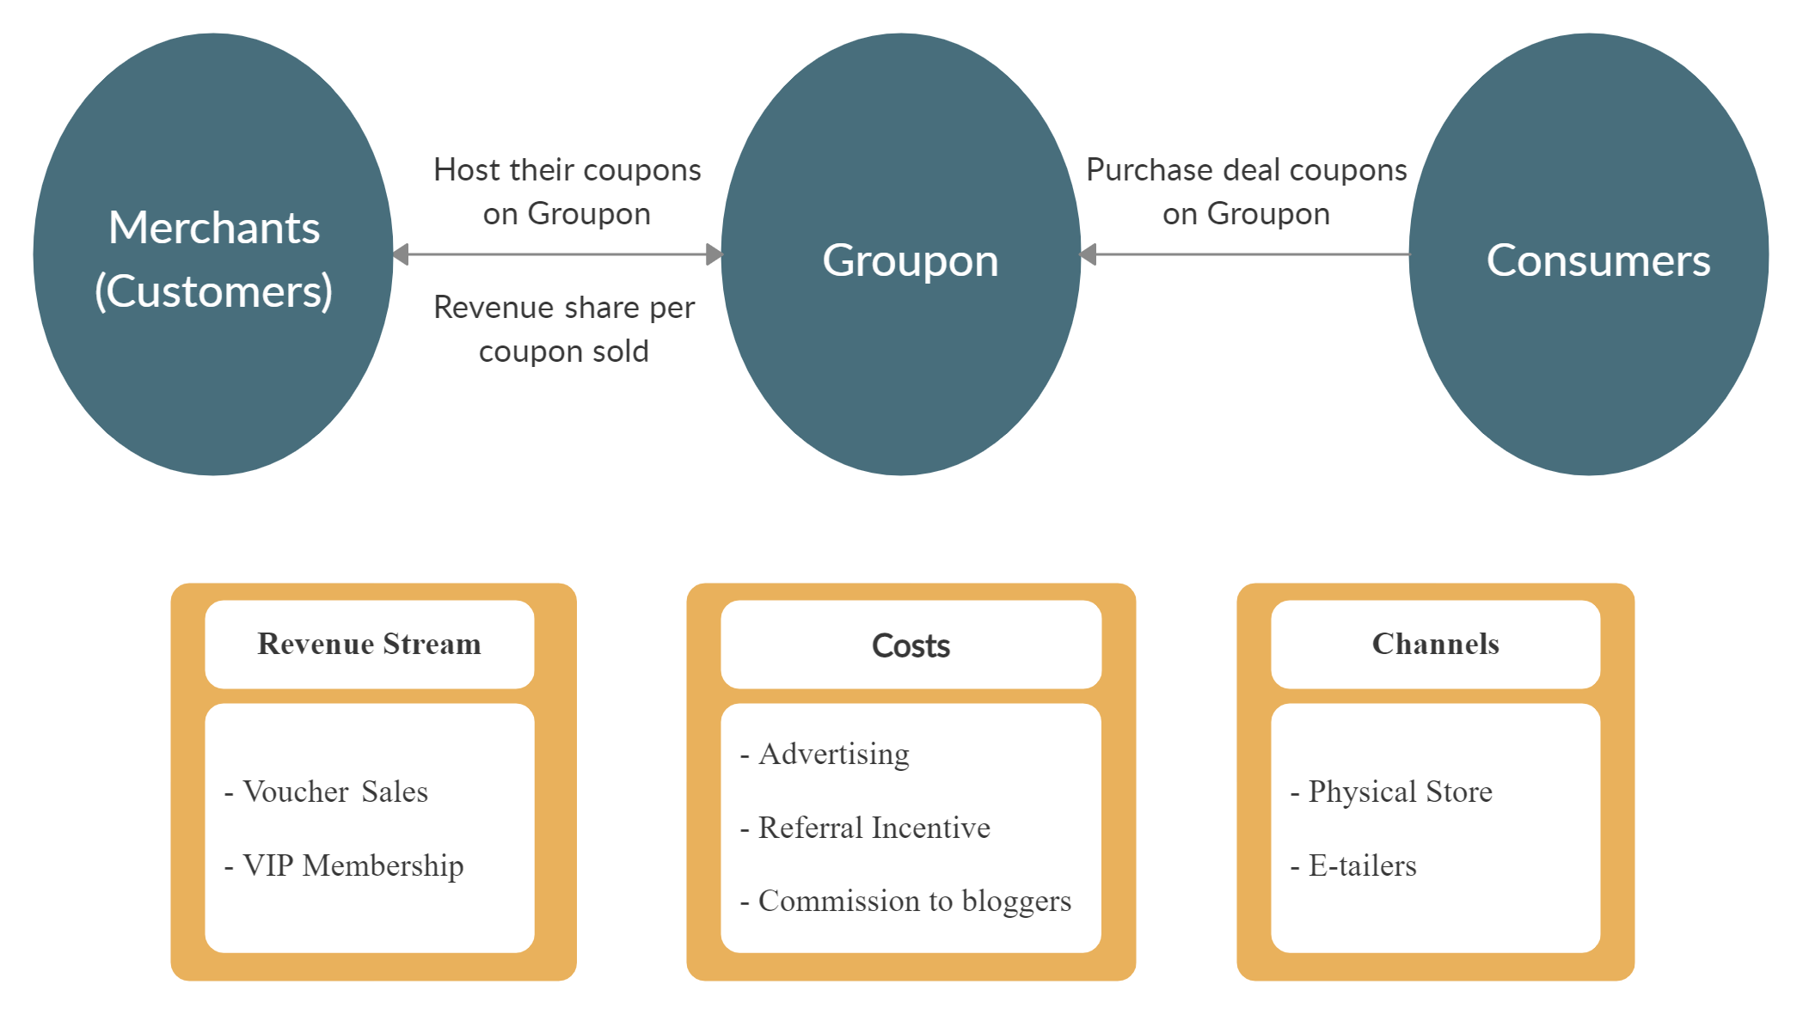
Business Model – Daily Deals

Slide 4
Is Groupon Sustainable?
Reluctance of merchants operating on low margins to share 50% revenue.
Longer wait time for merchants to receive revenue from Groupon and from their customers, due to indefinite redemption period.
Possibility of no coupon redemption, leading to lack of upsell opportunities and development of customer base for merchants.
Independent deals run by merchants to customers based on customer mailing list post Groupon deals.
Other better and economical marketing options available to merchants. i.e., Ads.
Restricted consumer base (young, well educated, high income, etc.)
Hence, not sustainable.

Slide 5
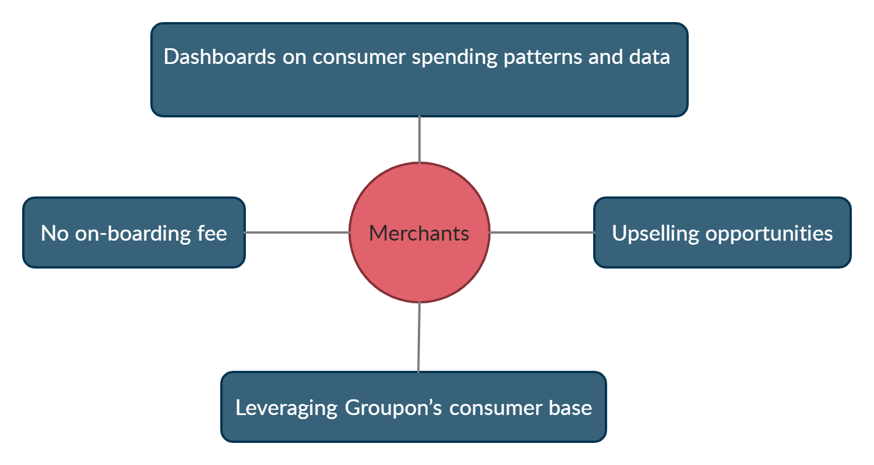
Business Appeal - Merchants
Notes:
Merchants
Opportunity to appeal to more customers from Groupon’s consumer base.
No on-boarding fee.
*tipping point
Upselling opportunities.
Independent campaign opportunities.
Dashboards on consumer spending patterns and data.
Consumers
Daily discount deals.
Early access to deal through the VIP membership program.
Refunds for affected customers.
Notifications regarding deals along follow up emails.
No of vouchers sold data for determining attractiveness of offers.
Referral Program for added credits.

Slide 6
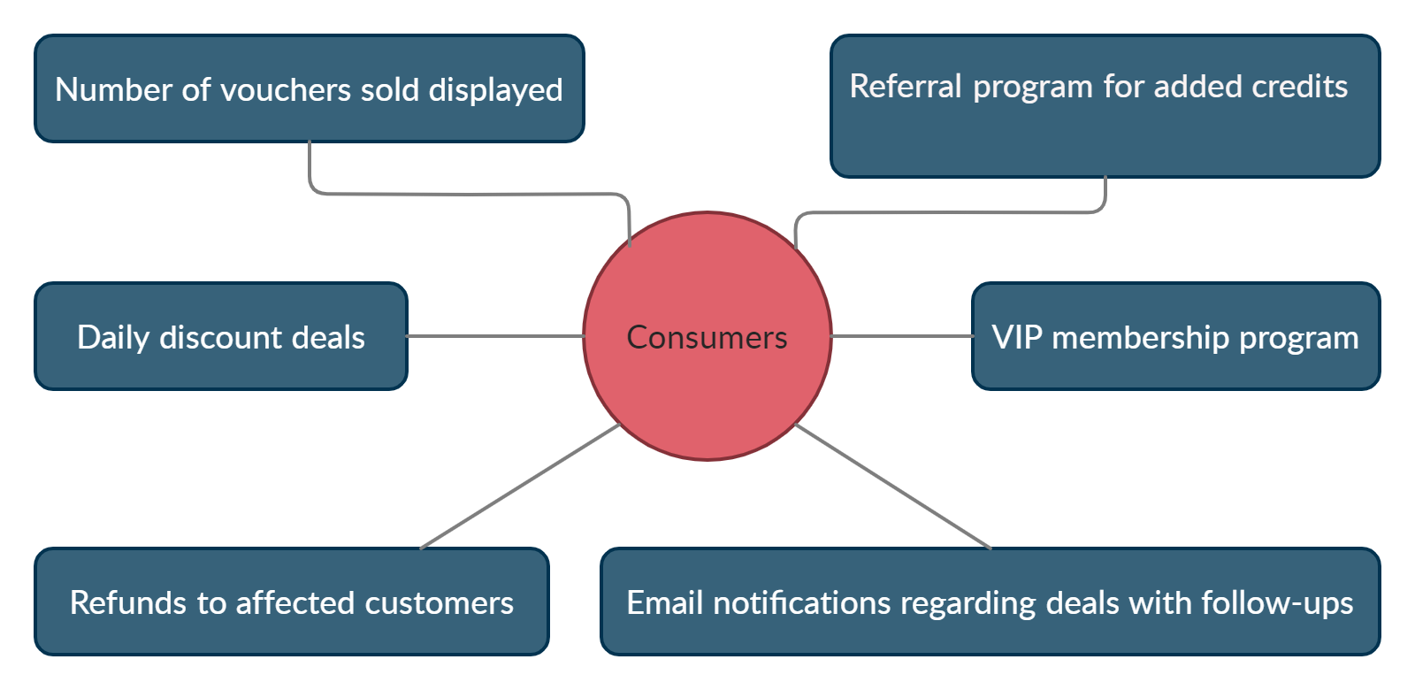
Business Appeal - CONSUMERS

Slide 7
American Apparel profitability
Revenue from vouchers ($25 * 133,000) = $3,325,000
Average $20 above face value revenue from customers.
25% of in-store redemption signed up for mailing list, which lead to additional 5-6 figure revenue through campaigns.
Increased profit margin by negotiating less than half revenue share to Groupon.
Assumptions
Costs were lower than the revenue generated from the Groupon campaign.
The mailing list developed were potential repeat customers.

Slide 8
WHY GROUPON 2.0?
Broadens competitive scope to attract new merchants and consumers (interest based)
Enhances customer retention through VIP program & Groupon Rewards.
Provides control to merchants, to run timed deals to boost business (Groupon Now)

Slide 9
Strategy against competition
Introducing lower revenue share between merchant & Groupon.
Attractive deals for referrals.
Exclusive rewards for consumers on the VIP program to create customer lock-in.
Increasing the width of services from merchants to cater to different consumer segments.
Focus on seamless consumer journey. Have efficient feedback mechanisms to track consumer satisfaction.
Preemptive approach to expand in other countries & establish strong hold in existing countries.
Scaling to mobile technologies.
Ensure quicker payments to the merchants.

Slide 10
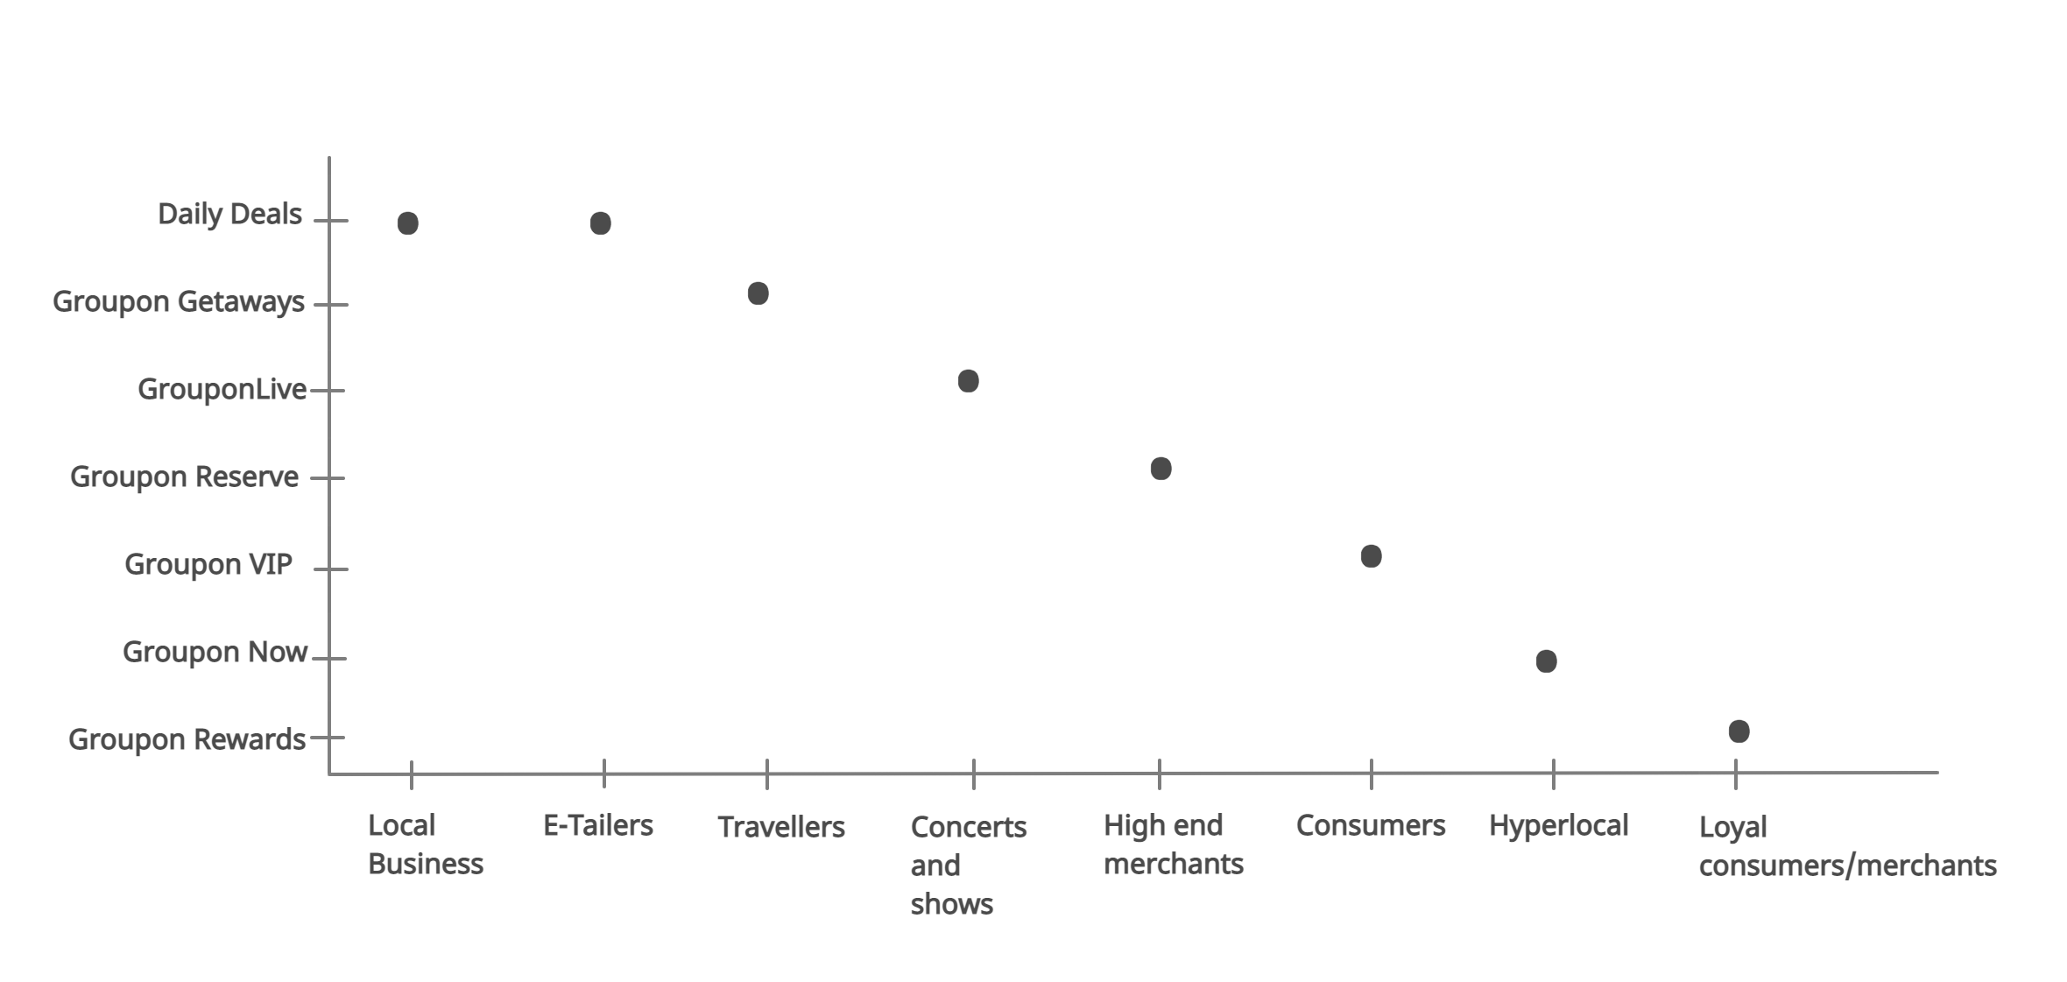
PRODUCT – MARKET GRAPH

Slide 11
THANK YOU

